Slide 1


Consumption, Saving and Investment

Slide 2
Consumption and Saving
Household budget constraint
  consumption+ real saving = real income
  C + (1/P) · ∆B+ ∆K = π/P + (w/P)·L + i·(B/P + K)
  假定：π/P = 0 (经济学利润=0)，
  则： C + (1/P)·∆B+ ∆K = (w/P)·L + i·(B/P + K)

Slide 3
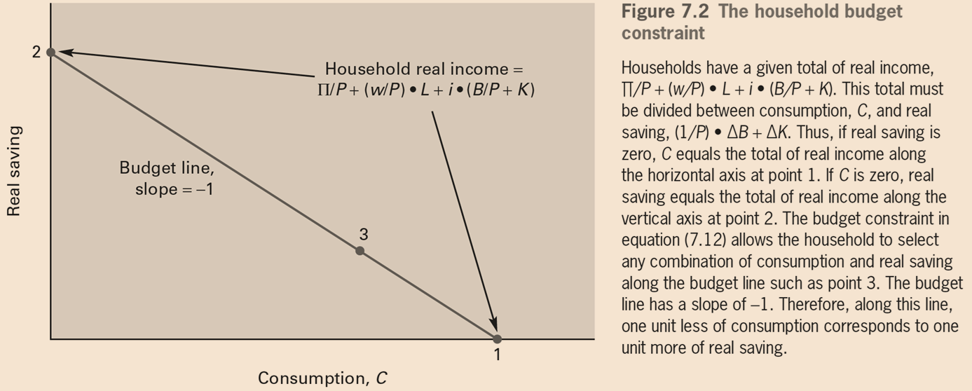
Consumption and Saving

Slide 4
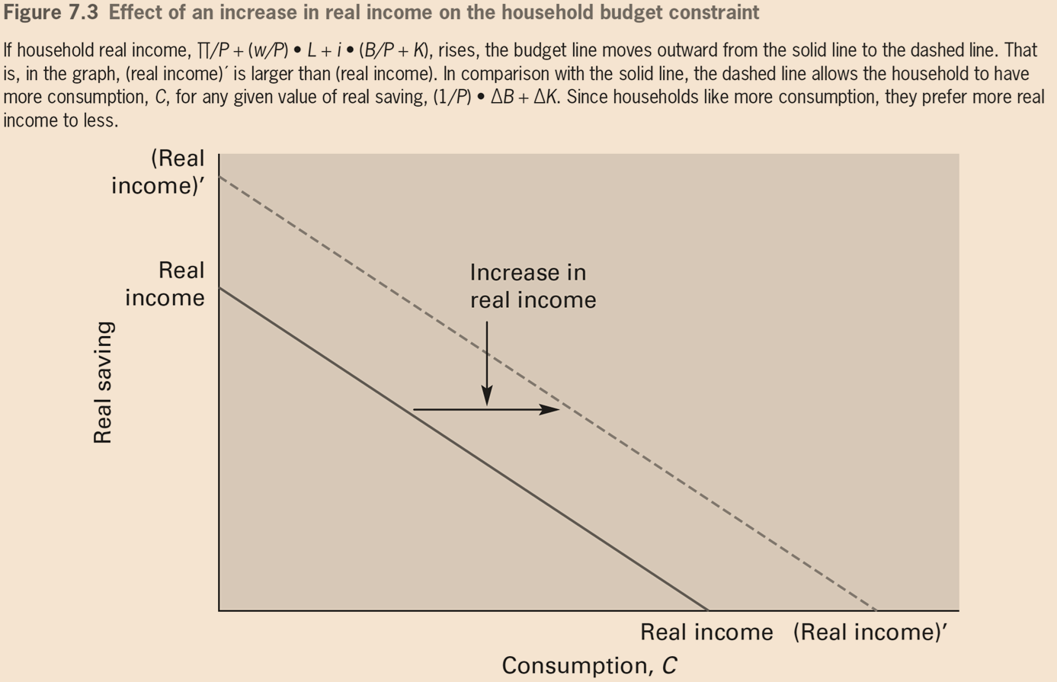

Slide 5
Consumption and Saving
Consumption Over Two Years
  Year₁
    C₁ + (B₁/P+K₁) − (B₀/P+K₀) =(w/P)₁ · L + i₀ · (B₀/P+K₀)
    consumption in year 1 + real saving in year 1 = real income in year 1
  Year₂
    C₂ + ( B₂/ P + K₂) − ( B₁/ P + K₁) =(w/P)₂ · L + i₁ · (B₁/P+K₁)
    consumption in year 2 + real saving in year 2 = real income in year 2

Slide 6
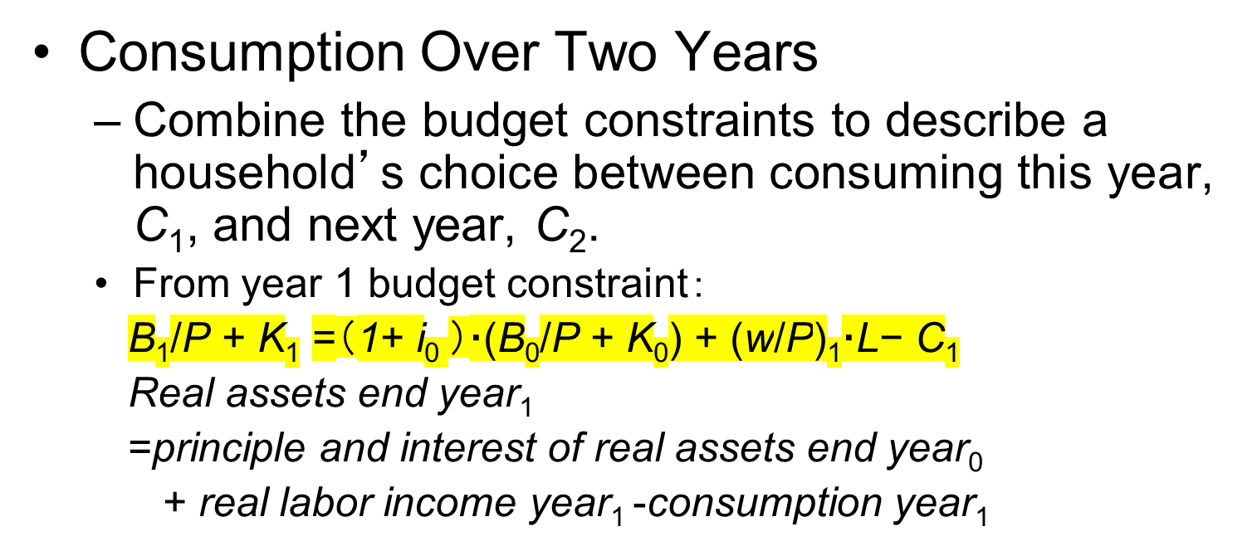
Consumption and Saving

Slide 7
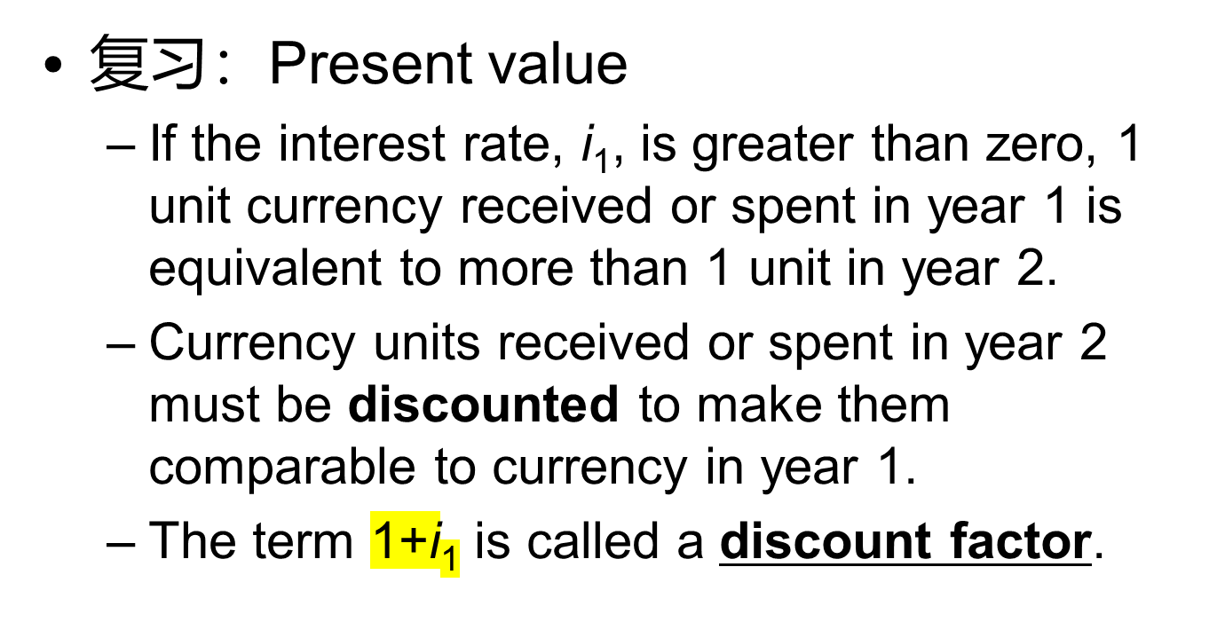
Consumption and Saving

Slide 8
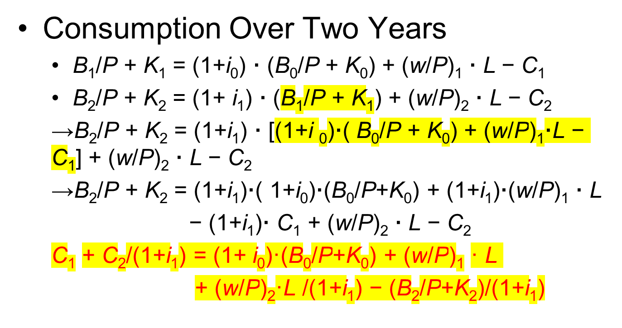
Consumption and Saving

Slide 9
Consumption and Saving
Choosing consumption: income effects
  Household chooses the time path of consumption—in this case, C₁ and C₂—to maximize utility, subject to the budget constraint.

Slide 10
Consumption and Saving
  C₁ + C₂/(1+i₁) = (1+ i₀)·(B₀/P+K₀) + (w/P)₁ · L
  + (w/P)₂·L/(1+i₁) − (B₂/P+K₂)/(1+i₁)
  pv of consumption = value of initial assets + pv of wage incomes − pv of assets end year ₂
  (B₂/P+K₂)/(1+i₁) ：财富存量，is going to be carried into the year 3, which cannot be consumed.

Slide 11
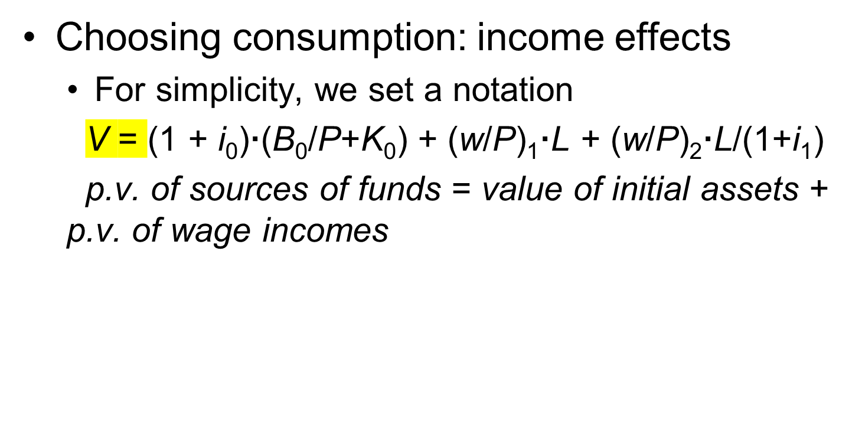
Consumption and Saving

Slide 12
Consumption and Saving
Choosing consumption: income effects
  C₁ + C₂/(1+i₁) = V − (B₂/P+K₂)/(1+i₁)
  p.v. of consumption = p.v. of sources of funds
  − p.v. of assets end year 2

Slide 13
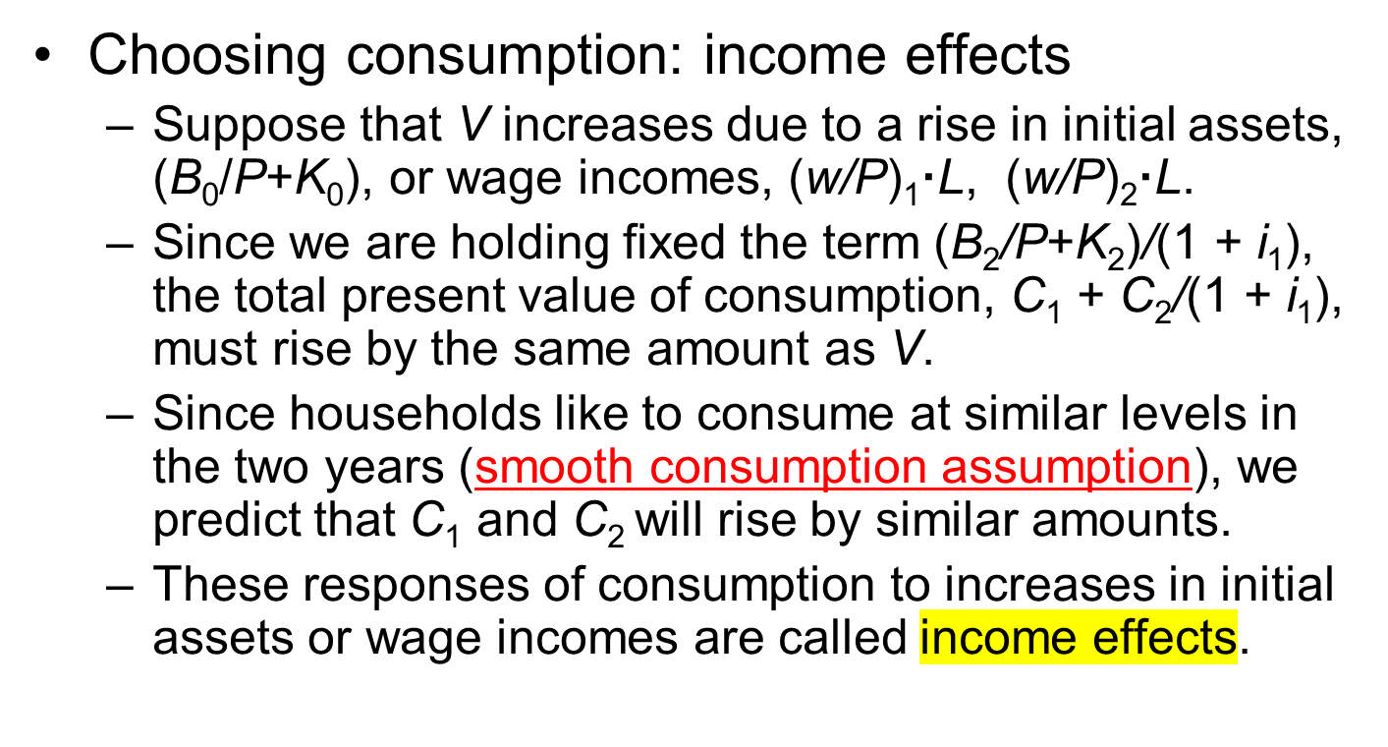
Consumption and Saving

Slide 14
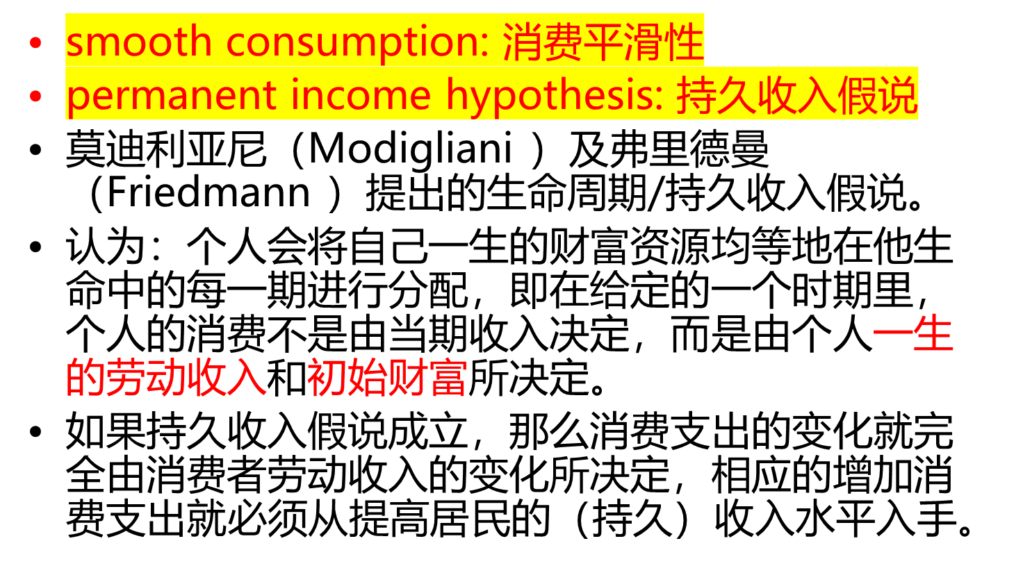
Smooth Consumption

Slide 15
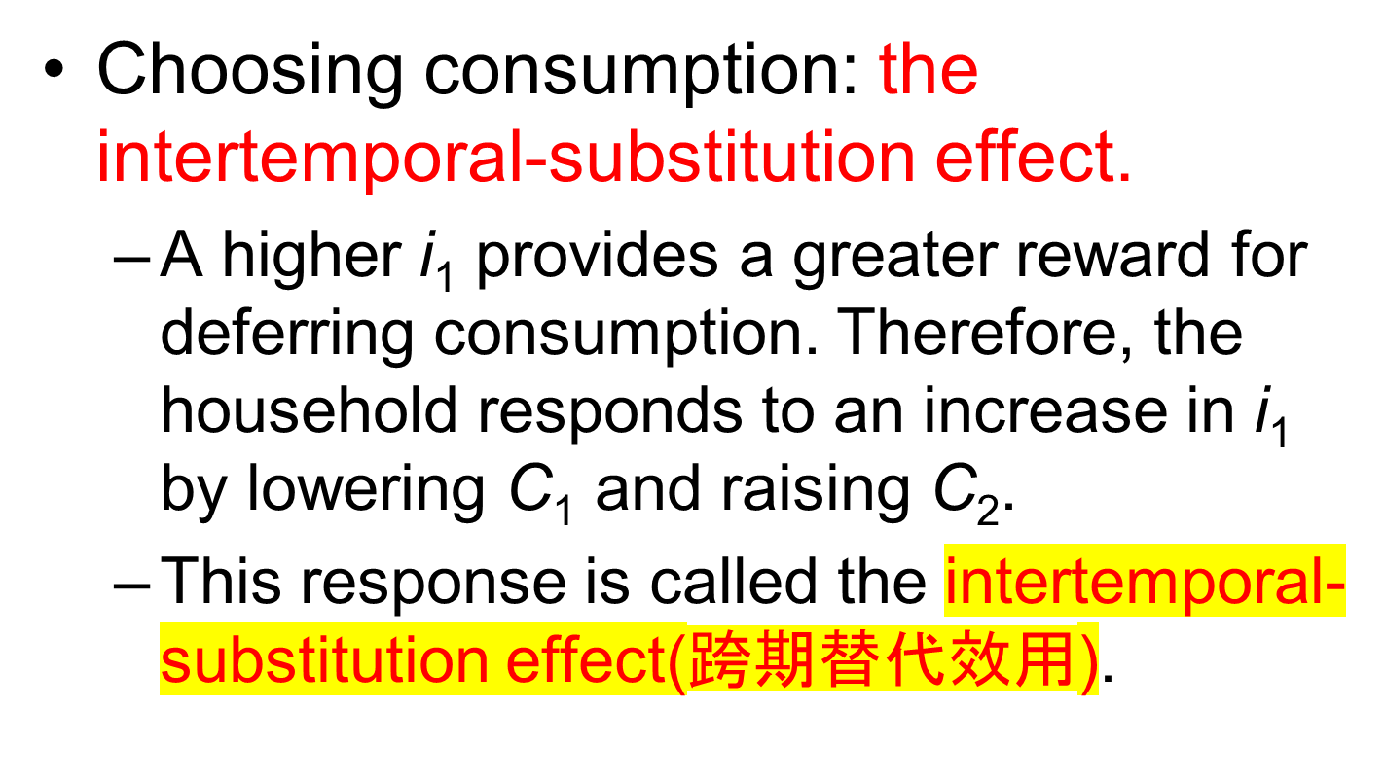
Consumption and Saving

Slide 16
Consumption and Saving
  So that this year’s consumption, C₁, falls on the left-hand side in the year 1’s budget constraint.
  C₁ + (B₁/P +K₁)−( B₀/P+K₀) = (w/P)₁·L + i₀·(B₀/P +K₀)

Slide 17
Consumption and Saving
  Since year 1’s real income, (w/P)₁·L + i₀·(B₀/P +K₀) on the right-hand side is given, the decline in C₁ must be matched by a rise in year₁’s real saving, (B₁/P + K₁) − (B₀/P + K₀).
  The intertemporal-substitution effect motivates the household to save more when the interest rate rises.

Slide 18
Consumption and Saving
A higher i₁ provides also income effect.
For year 2’s budget constraint:
C₂+(B₂/P +K₂) − (B₁/P+K₁) =(w/P)₂ · L + i₁·(B₁/P +K₁)
The income effect from i₁ in the item: [i₁·(B₁/P + K₁)]

Slide 19
Consumption and Saving
Combining income & intertemporal substitution effects
  The effect of an increase in the interest rate, i₁, on consumption, C₁ and C₂
    The intertemporal substitution effect motivates the household to reduce C₁ and increase C₂
    An increase in i₁ also has a positive income effect, motivating household to raise C₂

Slide 20
Consumption and Saving
Consumption Over Many Years
  Two-year budget constraint
    C₁ + C₂/(1+i₁) = (1+ i₀)·(B₀/P+K₀) + (w/P)₁ · L + (w/P)₂·L/(1+i₁) − ( B₂/P+K₂)/(1+i₁)

Slide 21
Consumption and Saving
Consumption and income in future years.
  overall present value of consumption
  C₁ + C₂/(1 + i₁) + C₃/[(1 + i₁)·(1 + i₂) ] + · · ·
  overall present value of wage income
  (w/P)₁·L + (w/P)₂·L/(1+i₁)+ (w/P)₂·L/[(1+i₁)·(1+i₂) ] + · · ·

Slide 22
Consumption and Saving
  Multiyear budget constraint:
    C₁ + C₂/(1 + i₁) + C₃/[(1 + i₁)·(1 + i₂) ] + · · · =
    (1+ i₀)·(B₀/P+K₀) +
    (w/P)₁·L + (w/ P)₂·L/(1+ i₁) +
    (w/P)₃·L/[(1+i₁)·(1+i₂) ] + · · ·
  Originally the last term in the two-year constraint, (B₂/P+K₂)/(1+i₁), becomes the present value of assets held in the distant future as (B_{n}/P+K_{n})/[(1+i₁)·(1+i₂) · · · (1+i_{n}) ]. Because of the discounting used to calculate the PV, we can neglect this trivial term

Slide 23
Consumption and Saving
Consumption Over Many Years
  Multi-Year budget constraint allows the comparison of the effects of temporary and permanent changes in income.

Slide 24
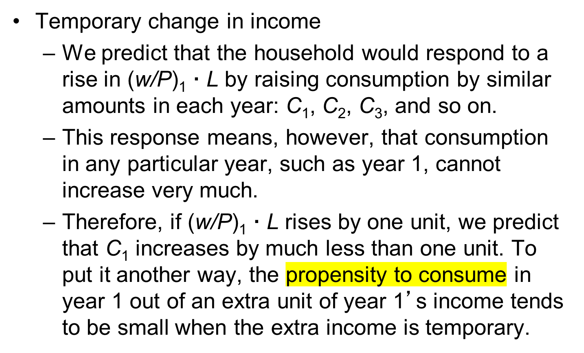
Consumption and Saving

Slide 25
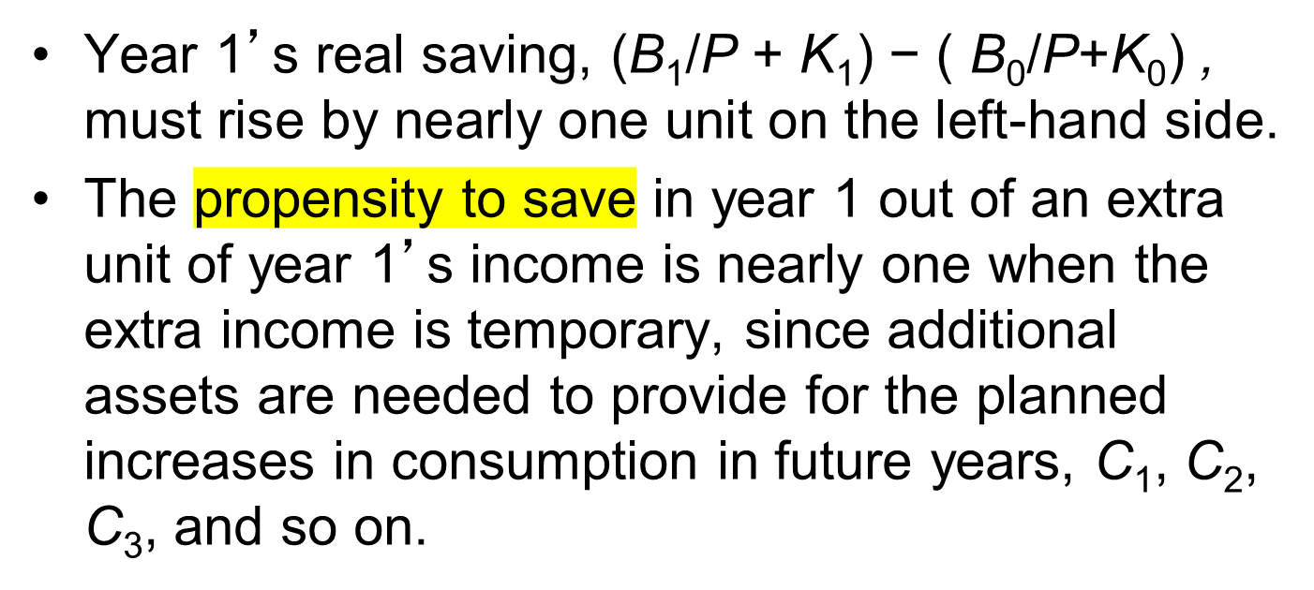
Consumption and Saving

Slide 26
Consumption and Saving
  Permanent increase in wage income
    (w/P)₁·L, (w/P)₂·L, (w/P)₃·L, and so on, each rise by one unit.
    It would be possible for the household to respond by increasing consumption by one unit in each year.

Slide 27
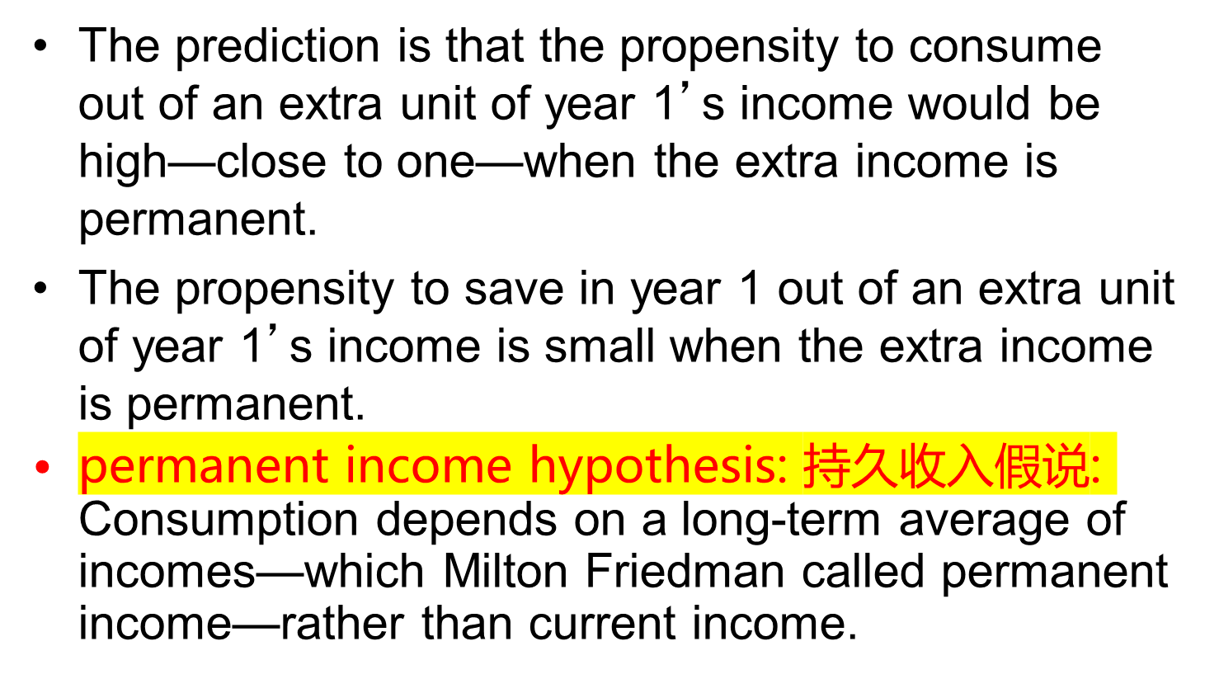
Consumption and Saving

Slide 28
Consumption, Saving and Investment in Equilibrium
Determine the aggregate quantities of consumption and saving.
Determine the aggregate quantity of investment.

Slide 29
Consumption, Saving and Investment in Equilibrium
Budget Constraint
  C + (1/P)·∆B+ ∆K = (w/P)·L + i·(B/P) + iK
    Where, i = (R/P − δ ), so
  C+ (1/P)·∆B+ ∆K = (w/P)·L + i·(B/P) + (R/P) · K − δ K
  B = 0 and ∆B = 0：when the bond market clears, households in the aggregate hold at a zero quantity of bonds. （实际上假定没有金融市场了，不存在杠杆）

Slide 30
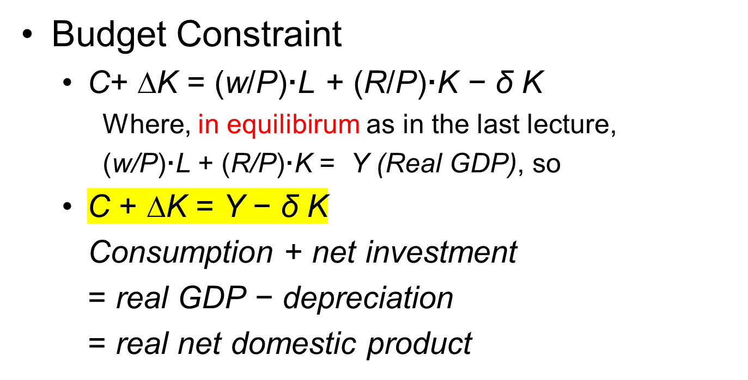
Consumption, Saving and Investment in Equilibrium

Slide 31
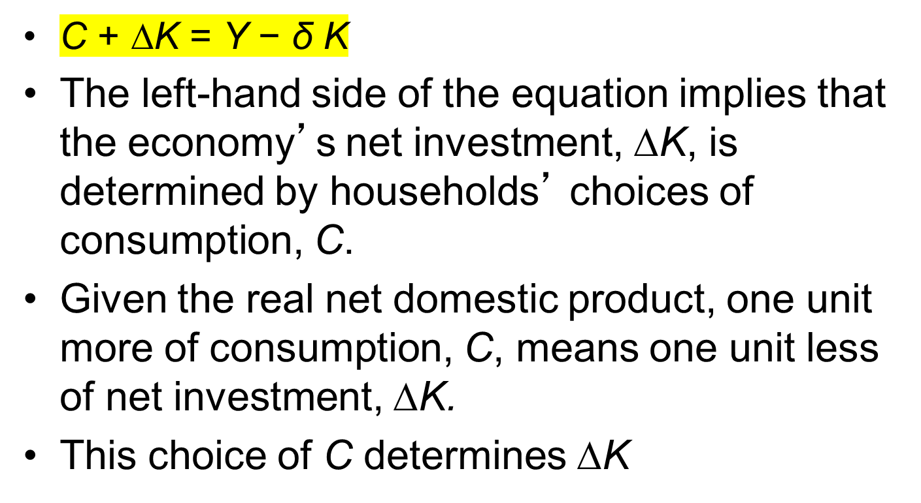
Consumption, Saving and Investment in Equilibrium

